Slide 1
I am I
By Marie-Louise Fitzpatrick

Slide 2
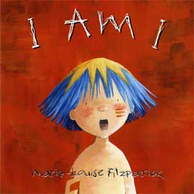
Overview

Slide 3
Response
I Am I has a strong theme.
Powerful, precise language presents the theme clearly.
I am I engages readers.
The illustrations are key in the story, as the words that the boys use become a symbol of their meaning.
Enduring questions:
What is the power of words?
What are the consequences of fighting? Of cooperating?

Slide 4
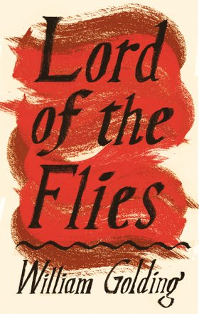
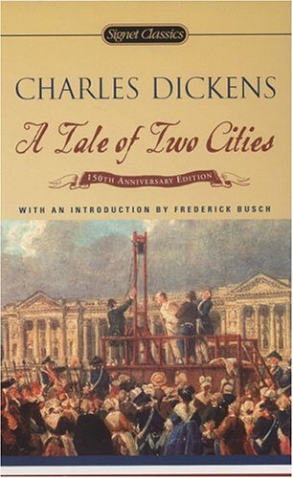
Possible Companion Pieces

Slide 5
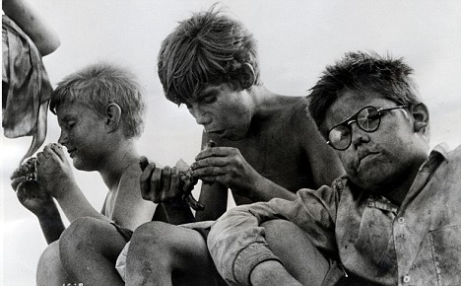
Lesson Ideas
1) The Power of Words: After reading I am I, have the students find quotations from Lord of the Flies that show destruction through the power of words in the same way. On a large poster, have them draw two of the opposing characters (much like two pages in the picture book) and use powerful quotes from the novel and creative illustration to show how the power of words can destroy and tear apart. This will help students to see how powerful and destructive words may be, and to learn how to analyze the characters and better understand the plot of the novel.
"How can you expect to be rescued if you don’t put first things first and act proper?“
-Piggy

Slide 6
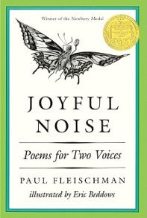
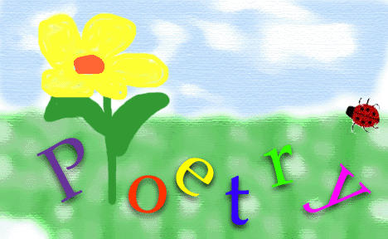
Lesson Ideas cont.
2) After reading the book I am I, have students write a “poem for two voices” that includes characters from Lord of the Flies.
For more ideas on Poems for two voices, check out Paul Fleischman’s book.

Slide 7
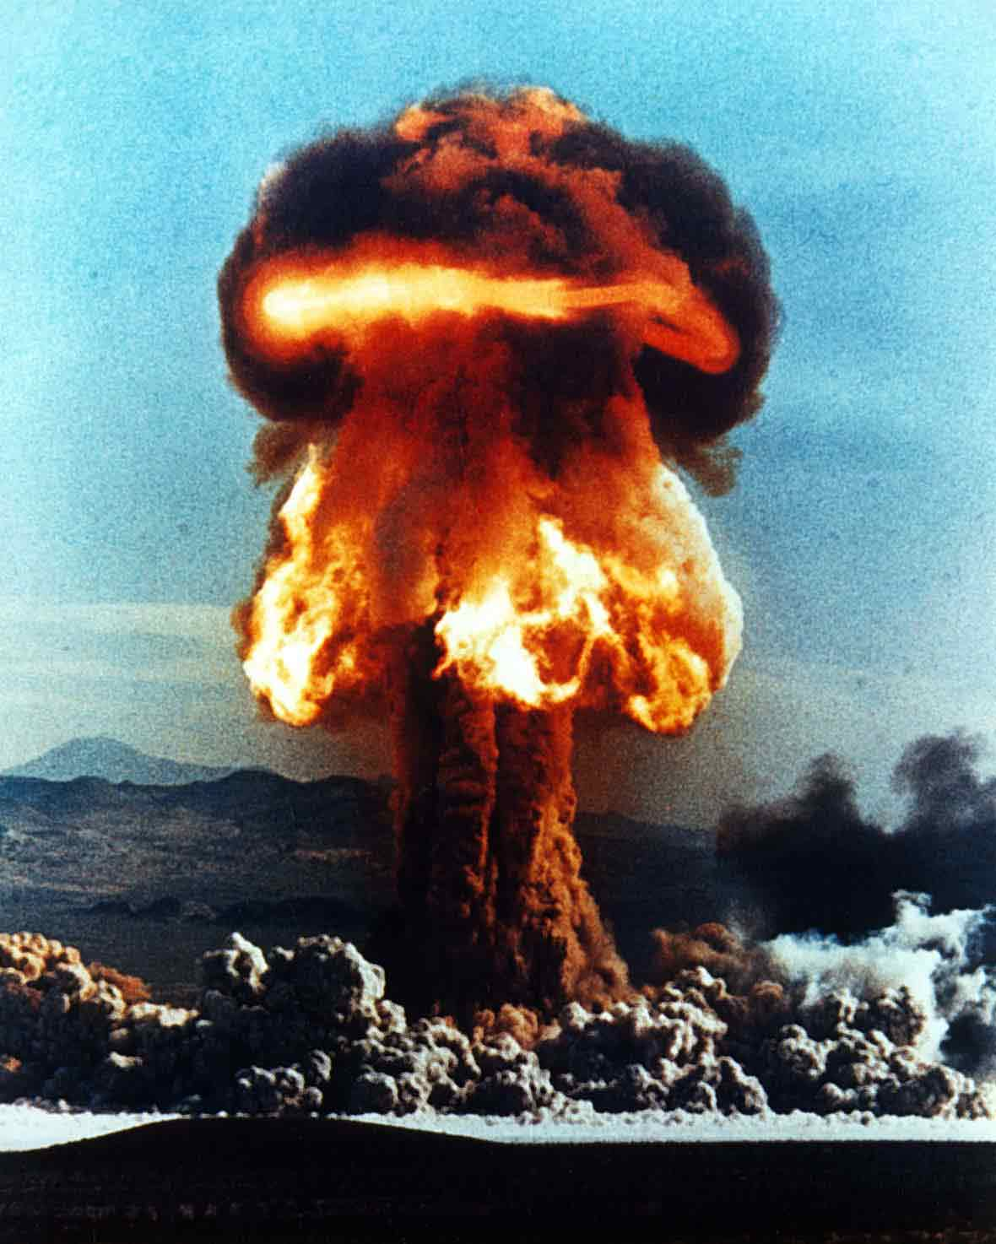
Lesson Ideas cont.
3) Have students list words that become dragons (i.e. I hate you, I’ll never forgive you, etc.) as well as words that grow into flowers (i.e. I love you, I forgive you, thank you). Hold a discussion where students brainstorm examples of the destructive and constructive power of words. Talk about the destructive power of words in Lord of the Flies.

Slide 8
fin

